Slide 1

Case Study: Modeling for Science Workforce Analysis
Richard C. Larson
Massachusetts Institute of Technology
(with Prof. Navid Ghaffarzadegan
Virginia Tech University)
Scientific Workforce Analysis and Modeling
1.203J, 15.073J, IDS.700
November 22, 2017

Slide 2

Outline
Lack of Mandatory Retirement for Professors
The “Birth Rate” of professors
Federal Research Funding: Small Changes can make a Big Difference
Reflections on Modeling

Slide 3
Non-Fixed Retirement Age for University Professors: Modeling its Effects on New Faculty Hires (with Mauricio Gomez Diaz)

Slide 4


Slide 5
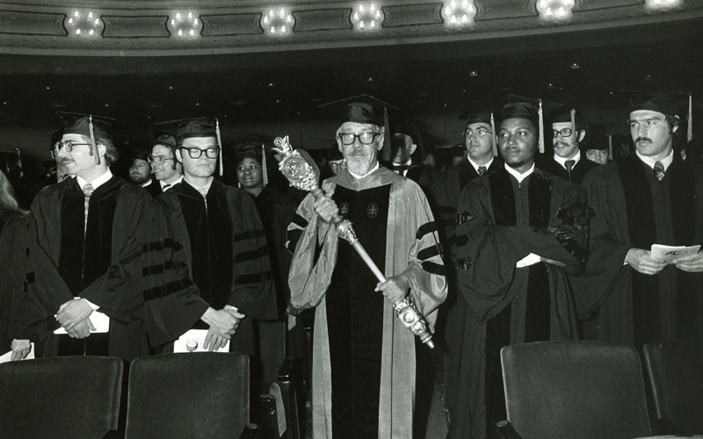

Issues
Tenure of university faculty members
Elimination of mandatory retirement age
First, 65 to 70. (1982)
Then, 70 to (1994)
(Age Discrimination & Employment Act 0f 1967, as amended from time to time)
Key question: How does elimination of mandatory retirement age affect the number of new faculty slots (for assistant professors) that are annually available?

Slide 6


Intuition
One might think that each of the two changes caused only transient effects. After the transient is over, the flows out and in will again balance in steady state and the number of new assistant professor slots will remain as before.
One word for this reasoning:

Slide 7

Think Like a Physicist
Suppose all faculty careers are precisely one year in length, and like MIT, there are 1,000 faculty members….
Then, how many new slots are available per year?
Now suppose we change things so that each faculty career is two years in duration.
Now, in steady state, how many new faculty slots are there each year?

Slide 8
A doubling of the length of a faculty career resulting in halving the annual number of new faculty slots.

Slide 9


Model 1: Steady State Queue
The queue is the set of tenure track faculty members currently employed. (N=1,000)
Then we use Little’s Law of Queueing:
Where
L ≡ the time-average number of “customers” in the queueing system;
≡ average rate at which new customers enter the system;
W ≡ the average time spent in the system by a random customer who enters.

Slide 10
Applied to University Faculties…
L ≡ the time-average number of tenure-track faculty members employed by the university;
≡ average annual rate at which new tenure-track faculty members join the faculty; and
W ≡ the average number of years spent on the faculty by a newly hired assistant professor.

Slide 11
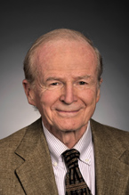
Applying Little’s Law
To apply Little’s Law we need to estimate W, the average number of years spent on the faculty by a typical new assistant professor.
Think of the key decision points made for and by this faculty member as she/he proceeds through her/his career.

Slide 12
Key Decision Points
At end of Year 2, reappointment as Assistant Professor without tenure.
At end of Year 4, appointment as Associate Professor without tenure (AWOT).
At end of Year 7, appointment as Associate Professor with Tenure.
Remaining on the faculty until retirement, not voluntarily departing from the university at some pre-retirement time.
Retirement from the faculty.

Slide 13
Details
P_{i} = conditional probability that milestone i is achieved, given that milestone (i - 1) is achieved, i=1, 2, 3, 4, 5.
Y_{i} = time from 1st appointment as assistant professor until milestone i is achieved.

Slide 14
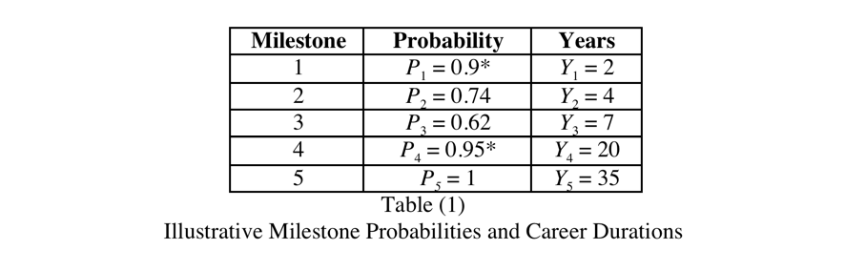

Slide 15
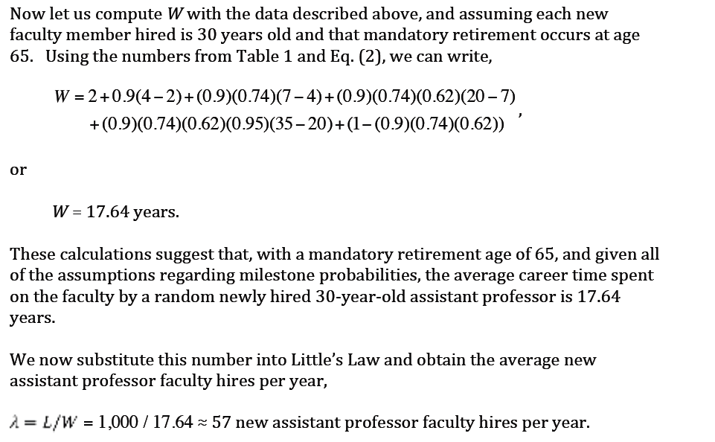

Slide 16
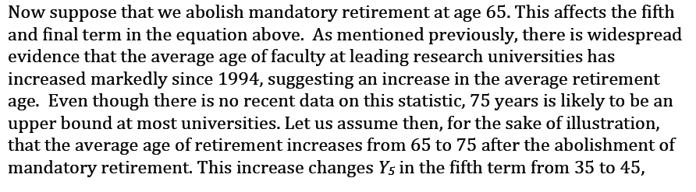
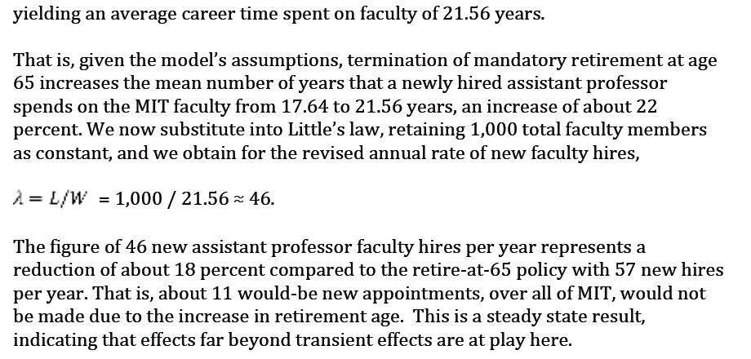

Slide 17
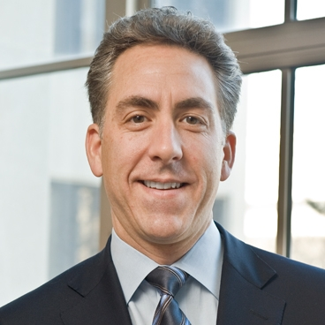
Retirement Model was used by Ian Waitz, former Dean, MIT School of Engineering

Slide 18

Birth Rates for University Professors

Slide 19
R₀ is defined as the mean number of new PhD’s that a typical tenure-track faculty member will graduate during his/her academic career
R₀ has roots in demography and epidemiology
MIT Estimate
1000 faculty members
500 Ph.D.’s granted per year
20 year average tenure-track career
R₀ = 10

Slide 20
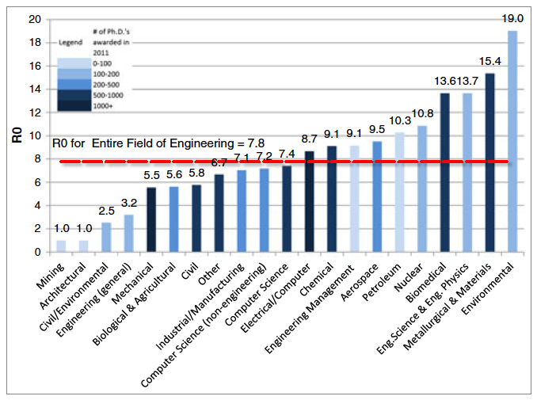
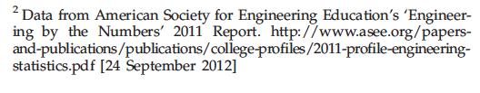

Slide 21
Remarks About R₀
Simple model, meant to frame differently.
In steady state only 1 of R₀ PhD’s can find an academic position.
Many engineering graduates do not seek academic positions.
Some take positions outside of USA.
Key insight: The system in many places is saturated, far beyond capacity to absorb new PhD’s in academia at current production rates.

Slide 22
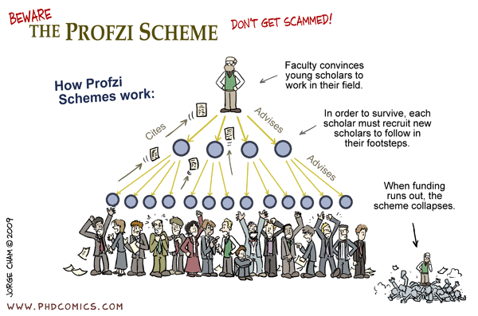

Slide 23
Dynamic Changes in NIH Research Funding

Slide 24

Focus of this presentation:
Effects of change in NIH funding levels
Published in the INFORMS journal, Service Science.
“Magnified Effects of Changes
in NIH Research Funding Levels”

Slide 25


Slide 26
Introduction
Most research centers operate on external funds.
We intuitively expect government funding policies to have substantial impacts on the performance of the research enterprise.
Many instances of abrupt changes in funding policies are observable.
NIH doubling 1998-2003
The “Stimulus” 2009 - 2010
Recent Sequestration (5—8% decline in funding)
What happens within the research enterprise when a federal funding agency abruptly changes research grant funding levels, up or down?

Slide 27
A Simple Model
Consider a federal agency that supports fundamental biomedical research.
It awards highly competitive research grants each year, with each grant flat-funded for four continuous years
i.e., 25% of the total grant amount is obligated and available to spend during each of the four years of the grant.

Slide 28
A Simple Model
B(Y) = Budget for research in year Y, Y = 1990, 1991, 1992,…
F(Y) = Funding available in year Y for new research grants.
F(y) = B(y) – [F(y-1) + F(y-2) + F(y-3)]

Slide 29
A Simple Model
B(Y) = Budget for research in year Y, Y = 1990, 1991, 1992,…
F(Y) = Funding available in year Y for new research grants.
F(y) = B(y) – [F(y-1) + F(y-2) + F(y-3)]
So, if total funding is historically flat at $10 billion/year (B(y)=10), Funding available in each year is F(y)=2.5, and total obligations is 7.5 [F(y-1) + F(y-2) + F(y-3)=7.5].

Slide 30
A Simple Model
suppose that year 2000 has a one-time increase to $12.5 billion, a 25% increase in total yearly funding. After that, funding drops back to $10 billion/year. What happens then?
?

Slide 31
A Simple Model
suppose that year 2000 has a one-time increase to $12.5 billion, a 25% increase in total yearly funding. After that, funding drops back to $10 billion/year. What happens then?
F(2000) = B(2000) – [F(1999) + F(1998) + F(1997)] = 12.5 – [2.5 + 2.5 + 2.5] = 5.0

Slide 32
A Simple Model
suppose that year 2000 has a one-time increase to $12.5 billion, a 25% increase in total yearly funding. After that, funding drops back to $10 billion/year. What happens then?
F(2000) = B(2000) – [F(1999) + F(1998) + F(1997)] = 12.5 – [2.5 + 2.5 + 2.5] = 5.0
F(2001) = B(2001) – [F(2000) + F(1999) + F(1998)] = 10 – [5 + 2.5 + 2.5] = 0.0
F(2002) = B(2002) – [F(2001) + F(2000) + F(1999)] = 10 – [0 + 5 + 2.5] = 2.5
F(2003) = B(2003) – [F(2002) + F(2001) + F(2000)] = 10 – [2.5 + 0 + 5] = 2.5
F(2004) = B(2004) – [F(2003) + F(2002) + F(2001)] = 10 – [2.5 + 2.5 + 0] = 5.0
F(2005) = B(2005) – [F(2004) + F(2003) + F(2002)] = 10 – [5 + 2.5 + 2.5] = 0.0

Slide 33
A Simple Model
suppose that year 2000 has a one-time increase to $12.5 billion, a 25% increase in total yearly funding. After that, funding drops back to $10 billion/year. What happens then?
F(2000) = B(2000) – [F(1999) + F(1998) + F(1997)] = 12.5 – [2.5 + 2.5 + 2.5] = 5.0
F(2001) = B(2001) – [F(2000) + F(1999) + F(1998)] = 10 – [5 + 2.5 + 2.5] = 0.0
F(2002) = B(2002) – [F(2001) + F(2000) + F(1999)] = 10 – [0 + 5 + 2.5] = 2.5
F(2003) = B(2003) – [F(2002) + F(2001) + F(2000)] = 10 – [2.5 + 0 + 5] = 2.5
F(2004) = B(2004) – [F(2003) + F(2002) + F(2001)] = 10 – [2.5 + 2.5 + 0] = 5.0
F(2005) = B(2005) – [F(2004) + F(2003) + F(2002)] = 10 – [5 + 2.5 + 2.5] = 0.0
(100% UP!!)
(100% Down!!)
Ups and Down

Slide 34
A Simple Model
suppose that year 2000 has a one-time increase to $12.5 billion, a 25% increase in total yearly funding. After that, funding drops back to $10 billion/year. What happens then?
F(2000) = B(2000) – [F(1999) + F(1998) + F(1997)] = 12.5 – [2.5 + 2.5 + 2.5] = 5.0
F(2001) = B(2001) – [F(2000) + F(1999) + F(1998)] = 10 – [5 + 2.5 + 2.5] = 0.0
F(2002) = B(2002) – [F(2001) + F(2000) + F(1999)] = 10 – [0 + 5 + 2.5] = 2.5
F(2003) = B(2003) – [F(2002) + F(2001) + F(2000)] = 10 – [2.5 + 0 + 5] = 2.5
F(2004) = B(2004) – [F(2003) + F(2002) + F(2001)] = 10 – [2.5 + 2.5 + 0] = 5.0
F(2005) = B(2005) – [F(2004) + F(2003) + F(2002)] = 10 – [5 + 2.5 + 2.5] = 0.0
(100% UP!!)
(100% Down!!)
Ups and Down
A 25% change in total funding at Year 2000, increases competing funds at year 2000 by 4*25% =100%.

Slide 35
“The Rule of Four”:
Starting from steady state, an X percent change in this year’s funding results in a 4X% change in new funding for this year.

Slide 36
The Awarding of Different Period Research Grants
τ = mean duration of a new research grant.
“The Rule of τ”:
Starting from steady state, an X percent change in this year’s funding results in a τ X% change in new funding for this year.

Slide 37
The Case Study
Application to the Case of NIH
To make the numbers simple to remember, say that the 1998 funding level was $10 billion and the 2003 level was doubled to $20 billion.
We assume that all grants are flat-funded for four years.
Scenarios:
1. Constant, linear increments (Constant 20% of base added to total budget per year)
2. Fixed percentage increments (Constant 14.9% increase in total budget per year)
3. Manually adjusted increments (The authors’ manually adjusted increases, with attempt to minimize disruption.)

Slide 38
The Case Study Analysis set-up
Scenario |  |  | Year
 |  |  | 1998 | 1999 | 2000 | 2001 | 2002 | 2003 | 2004 | 2005 | 2006 | 2007
1. Constant linear increments
 | Input: | Total Budget (B) | 10 | 12 | 14 | 16 | 18 | 20 | 20 | 20 | 20 | 20
 | Outputs: | Commitment (C) | 7.5 | ? | ? | ? | ? | ? | ? | ? | ? | ?
 |  | New Funding (F) | 2.5 | ? | ? | ? | ? | ? | ? | ? | ? | ?
 |  | Change in F (%∆F) | 0% | ? | ? | ? | ? | ? | ? | ? | ? | ?
2. Fixed percentage increments
 | Input: | Total Budget (B) | 10 | 11.5 | 13.2 | 15.2 | 17.4 | 20 | 20 | 20 | 20 | 20
 | Outputs: | Commitment (C) | 7.5 | ? | ? | ? | ? | ? | ? | ? | ? | ?
 |  | New Funding (F) | 2.5 | ? | ? | ? | ? | ? | ? | ? | ? | ?
 |  | Change in F (%∆F) | 0% | ? | ? | ? | ? | ? | ? | ? | ? | ?
3. Manually adjusted increments
 | Input: | Total Budget (B) | 10 | 11 | 12.6 | 15 | 18 | 20 | 20 | 20 | 20 | 20
 | Outputs: | Commitment (C) | 7.5 | ? | ? | ? | ? | ? | ? | ? | ? | ?
 |  | New Funding (F) | 2.5 | ? | ? | ? | ? | ? | ? | ? | ? | ?
 |  | Change F (%∆F) | 0% | ? | ? | ? | ? | ? | ? | ? | ? | ?

Slide 39
The Case Study Analysis set-up
Scenario |  |  | Year
 |  |  | 1998 | 1999 | 2000 | 2001 | 2002 | 2003 | 2004 | 2005 | 2006 | 2007
1. Constant linear increments
 | Input: | Total Budget (B) | 10 | 12 | 14 | 16 | 18 | 20 | 20 | 20 | 20 | 20
 | Outputs: | Commitment (C) | 7.5 | 7.5 | 9.5 | 11.5 | 13.5 | 13.5 | 15.5 | 15.5 | 15.5 | 13.5
 |  | New Funding (F) | 2.5 | 4.5 | 4.5 | 4.5 | 4.5 | 6.5 | 4.5 | 4.5 | 4.5 | 6.5
 |  | Change in F (%∆F) | 0% | 80% | 0% | 0% | 0% | 44% | -31% | 0% | 0% | 44%
2. Fixed percentage increments
 | Input: | Total Budget (B) | 10 | 11.5 | 13.2 | 15.2 | 17.4 | 20 | 20 | 20 | 20 | 20
 | Outputs: | Commitment (C) | 7.5 | 7.5 | 8.99 | 10.7 | 12.7 | 13.4 | 15.8 | 15.5 | 15.2 | 13.4
 |  | New Funding (F) | 2.5 | 3.99 | 4.21 | 4.46 | 4.75 | 6.58 | 4.21 | 4.46 | 4.75 | 6.58
 |  | Change in F (%∆F) | 0% | 59% | 6% | 6% | 7% | 38% | -36% | 6% | 7% | 38%
3. Manually adjusted increments
 | Input: | Total Budget (B) | 10 | 11 | 12.6 | 15 | 18 | 20 | 20 | 20 | 20 | 20
 | Outputs: | Commitment (C) | 7.5 | 7.5 | 8.5 | 10.1 | 12.5 | 14.5 | 15.9 | 15.1 | 14.5 | 14.5
 |  | New Funding (F) | 2.5 | 3.5 | 4.1 | 4.9 | 5.5 | 5.5 | 4.1 | 4.9 | 5.5 | 5.5
 |  | Change F (%∆F) | 0% | 40% | 17% | 20% | 12% | 0% | -25% | 20% | 12% | 0%

Slide 40
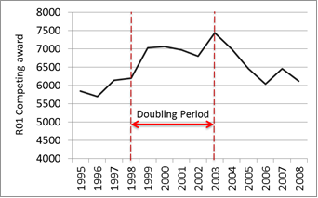
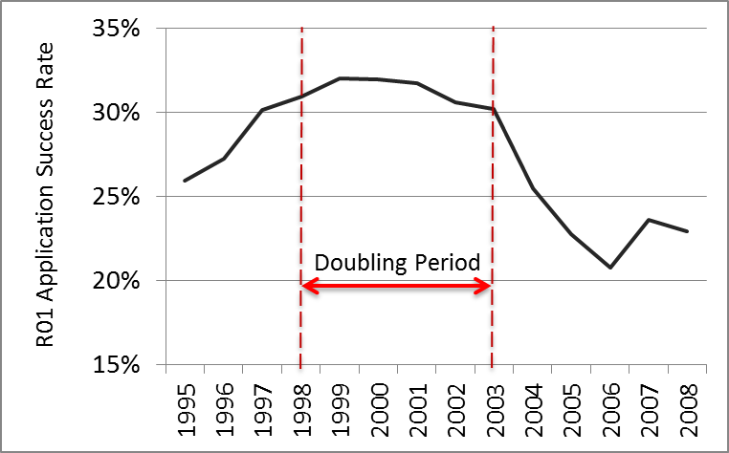
The Case Study
Details of the NIH Doubling of Research Funding
Annual Numbers of R01 Competing Awards
R01 Application Success Rate, by Year

Slide 41
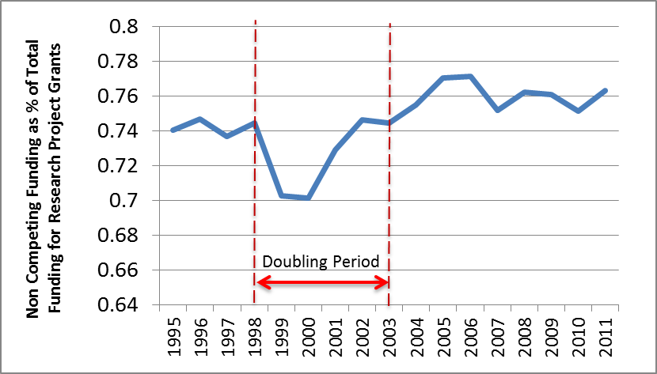
The Case Study
Details of the NIH Doubling of Research Funding
Percent of funding for Research Project Grants Obligated to Awards from Prior Years

Slide 42
Alternative Policies
“Are there any corrective steps that can be taken to reduce Early Euphoria and Severe Hangover?”
The answer is Yes.
We conducted a set of optimizations for changing funding step sizes, and grant duration, and both

Slide 43
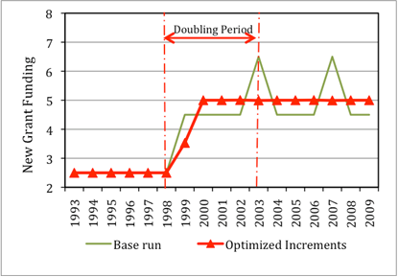
Alternative Policies: Changing Funding Step Sizes
 | Activity variable: Annual Budget
Year | 1998 | 1999 | 2000 | 2001 | 2002 | 2003
1. Base run (Linear) | 10 | 12 | 14 | 16 | 18 | 20
2. Optimized increments | 10 | 11.03 | 13.53 | 16.03 | 18.54 | 20

Slide 44
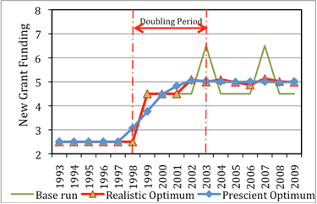
Alternative Policies: Changing Grant Durations
 |  | Year
Scenarios |  | 1995 | 1996 | 1997 | 1998 | 1999 | 2000 | 2001 | 2002 | 2003 | 2004
1. Base Run
% | 3yr | 0% | 0% | 0% | 0% | 0% | 0% | 0% | 0% | 0% | 0%
% | 4yr | 100% | 100% | 100% | 100% | 100% | 100% | 100% | 100% | 100% | 100%
% | 5yr | 0% | 0% | 0% | 0% | 0% | 0% | 0% | 0% | 0% | 0%
2. Realistic Optimum
% | 3yr | 0% | 0% | 0% | 0% | 13% | 0% | 2% | 4% | 0% | 3%
% | 4yr | 100% | 100% | 100% | 100% | 66% | 91% | 97% | 95% | 99% | 97%
% | 5yr | 0% | 0% | 0% | 0% | 20% | 9% | 1% | 1% | 1% | 0%

Slide 45
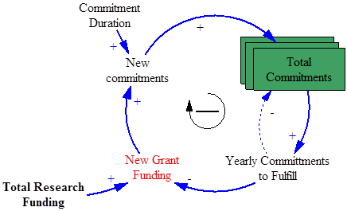
Discussion
Structural Source of Instability:
The amplified effect is mainly due to grants lasting for an extended period, thereby requiring the majority of funds available in one year to pay for grants awarded in previous years.

Slide 46

We were contacted by NIH Heart, Lung and Blood Institute.
Resource allocation is a serious problem in the time of sequester.
They thought the paper and the model is highly relevant to their problem in hand.
There is actual need for a more comprehensive model of funding allocation.

Slide 47

Make things as simple as possible, but not simpler

Slide 48
Caveats
This is a simple model developed to analyze overall dynamics of change in NIH funding.
For a model that helps decision making at the NIH level and offers precise estimations of the effects further modeling efforts are needed.

Slide 49
Reflections on Modeling
Structural Source of Instability.
Our intention was to illustrate a source of complexity
Magnified effects.
No single variable fixes the problem
Need to use different policy variables: e.g., percentage cut in commitments, duration of grants, change increments, …

Slide 50
Contributions
Methodological contributions
How to use simple illustrative mathematical models to provide policy insights.
Opportunity:
Combinations of rich data in healthcare domain with mathematical models in systems engineering
Dynamic questions in healthcare; better before worse patterns, oscillations, etc.
Simulation frameworks for what-if analysis

Slide 51


Slide 52

Role of equation-based axiomatic models
Vs. say data-fitted models
Data needs: large or small?
Simulation
Deterministic (as in linear equation model)
Deterministic (as in System Dynamics)
Probabilistic (Monte Carlo, discrete event)
Agent-Based Models (ABM)
Hazards of models, limitations?

